Slide 1

ARBA MINCH UNIVERSTY, ARBAMINCH INSTITUTE OF TECHNOLOGY
Faculty of Computing and Software Engineering
Mobile Application Development (SEng6241)
By: Behayilu Metiku
Sep 22, 2025

Slide 2
CHAPTER ONE
INTRODUCTION
By: Behayilu M.
Faculty of Computing and Software Engineering(FCSE),
Arba Minch Institute of Technology(AMiT),
Arba Minch University

Slide 3
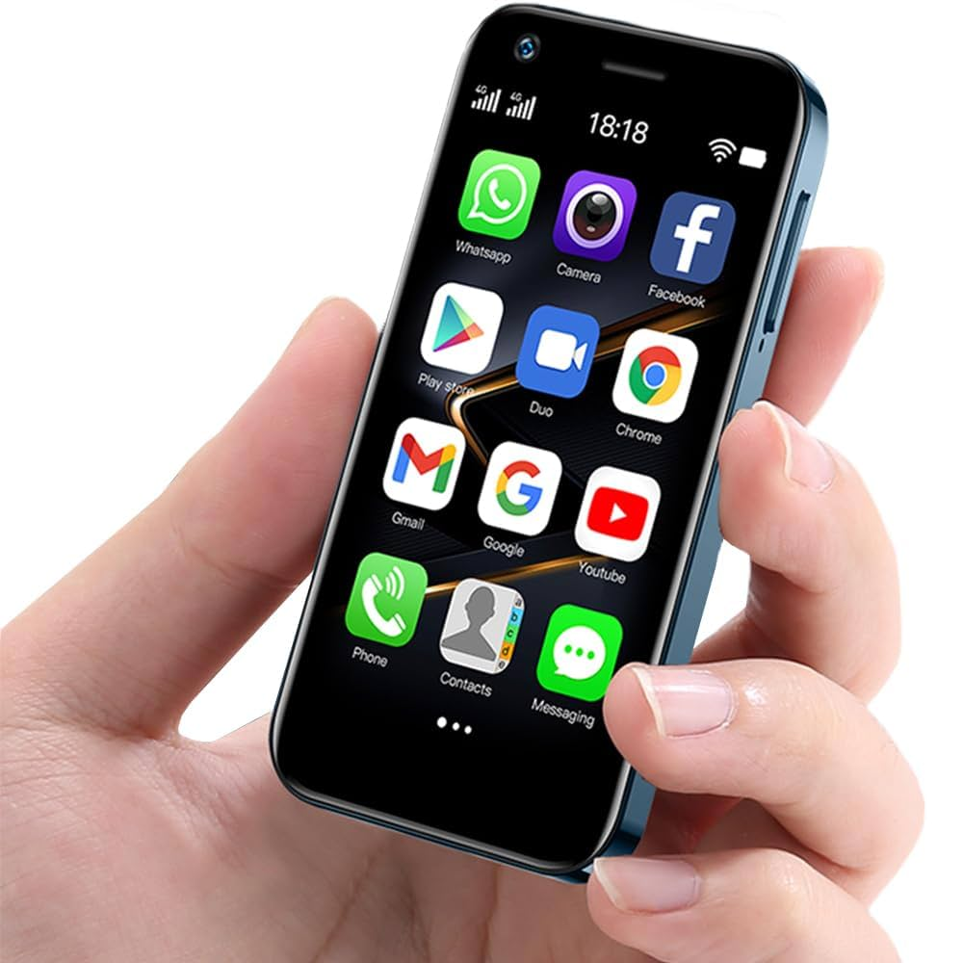
CONTENTS
What is Mobile Application Development?
Explain Mobile Computing
Explain about Major Mobile Development Platforms
Development approaches

Slide 4
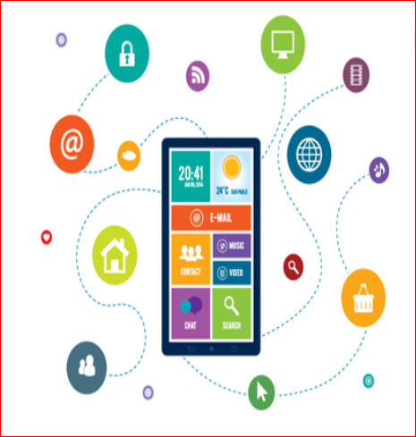
Introduction
Every day new devices are incoming to the market with innovative options thanks to growing technology.
The evolution of mobile application development technology with new devices made our lives much easier.

Slide 5
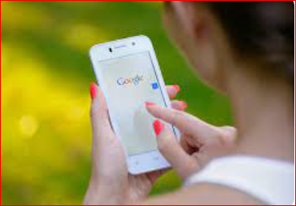
Introduction
In the smartphone world, simply having a running website is not enough.
A recent study has shown that about 45% and more of Google search happens using smartphones.
Mobile development is doing any reasonable development for any kind of mobile device such as developing apps for phones, tablets, smartwatches, and every form of wearable device that run any kind of mobile operating system.

Slide 6
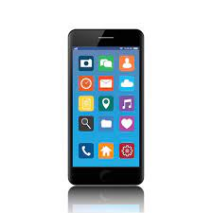
What is Mobile Application Development?
Mobile Application Development is the process of creating software applications that run on mobile devices such as smartphones and tablets.
These applications can be pre-installed on devices, downloaded from app stores, or accessed through a web browser.
The development process involves designing, coding, testing and deploying apps that meet user needs and expectations.

Slide 7
Mobile Computing
Computing – is the operations of the computer.
Nomadic / Mobility - is that someone / something can move or be moved easily and quickly from place to place.
Mobile
Computing
Mobile computing

Slide 8
Mobile Computing - definitions
A human–computer interaction in which a computer is expected to be transported during normal usage and allow for transmission of data, which can include voice and video transmissions. Mobile computing involves mobile communication, mobile hardware, and mobile software. _{According to Wikipedia website}
It is a technology that provides an environment that enables users to transmit data from one device to another device without the use of any physical link or cables. _{According to JavaTpoint}
Refers to the set of IT technologies, products, services and operational strategies and procedures that enable end users to access computation, information and related resources and capabilities while mobile. Mobile most commonly refers to access in motion, where the user is not restricted to a given geographic location. _{-- According to TechTarget}

Slide 9
Mobile Computing - definitions
The term “mobile computing” refers to a group of IT tools, services, and operational methods that allow users to access computing, data, and related resources and capabilities while on the go. _{– According to Dataconomy}
Mobile computing is a rapidly evolving field that is revolutionizing the way we work and communicate. It refers to the use of portable computing devices, such as smartphones, tablets, and laptops, to access digital information and services while on the move. With the increasing availability of high-speed mobile networks, mobile computing has become an integral part of our daily lives. _{--According to ChatGPT}

Slide 10
A computing environment is defined as mobile if it supports one or more of these characteristics:
User is mobile
Network is mobile
Device is mobile
Service is mobile
Session is mobile

Slide 11

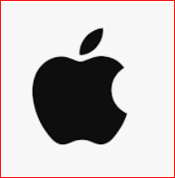
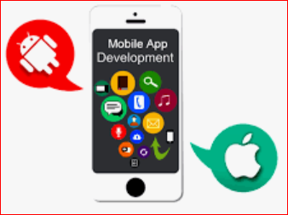
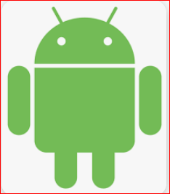
Major Mobile Development Platforms

Slide 12
iOS
iOS is the “big platform” app development platform
Apple provides iOS developers with many native tools and libraries to develop iOS applications
You just need to have a mac running OS X to build your application
iOS is developed by Apple, and it runs exclusively on Apple products

Slide 13
Android vs iOS
Android is backed by Google
iOS is backed by Apple
Anyone can build an Android app, and it is designed to run on a variety of different hardware platforms and devices with very different form factors and capabilities
iOS is designed to run only on a specific set of Apple devices
Android is based on the Linux kernel, and Google releases the source code for Android as open source
Like Apple, Google provides some native tools for Android development but again you are not required to use them

Slide 14
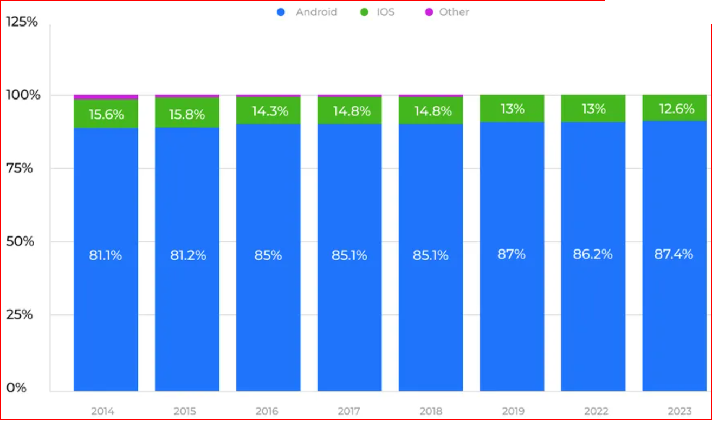
Android & iOS market share

Slide 15
Mobile Application Development Languages
The most popular programming languages for mobile application development are:-
Java and Kotlin for android app development
Swift and Objective-C for iOS development
C# for cross-platform development using Xamarin framework
Dart for the development of cross-platform apps using Flutter
JavaScript and TypeScript for cross-platform development with React Native framework
Web technologies like HTML,CSS, and JavaScript for cross-platform development with Ionic framework

Slide 16
Types of Mobile Apps
Based on technology the used in their development, mobile applications are of three main types.
Native apps
Web apps( browser based app) and
Hybrid apps

Slide 17
Native Apps
Native apps are built specifically for a particular platform(Android, iOS) using platform specific programming languages and tools.
Native apps are “native” to one platform – you will need to create different apps for Android, iOS, etc.
You can distribute native apps through play store /app store and install them on devices.
Native development technologies include: Java/Kotlin with XML for android and Swift/Objective-C for iOS.
If you want your app to run on Android and iOS, you will have to develop the app twice, once for each OS.

Slide 18
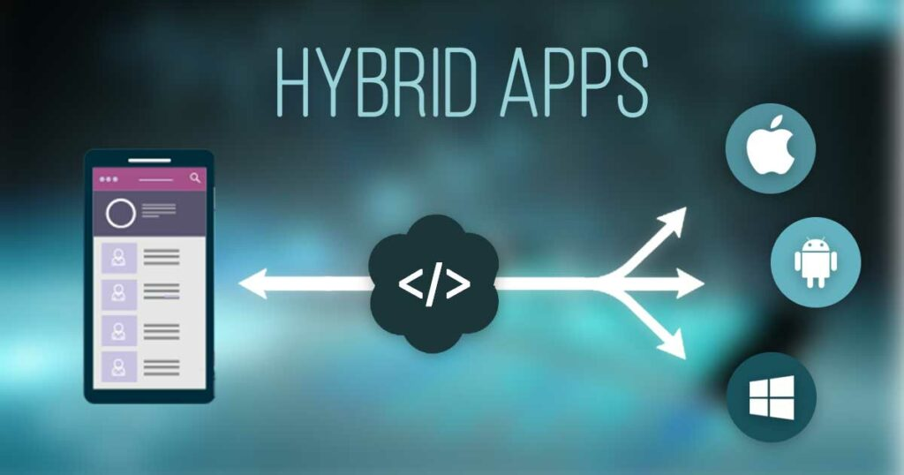
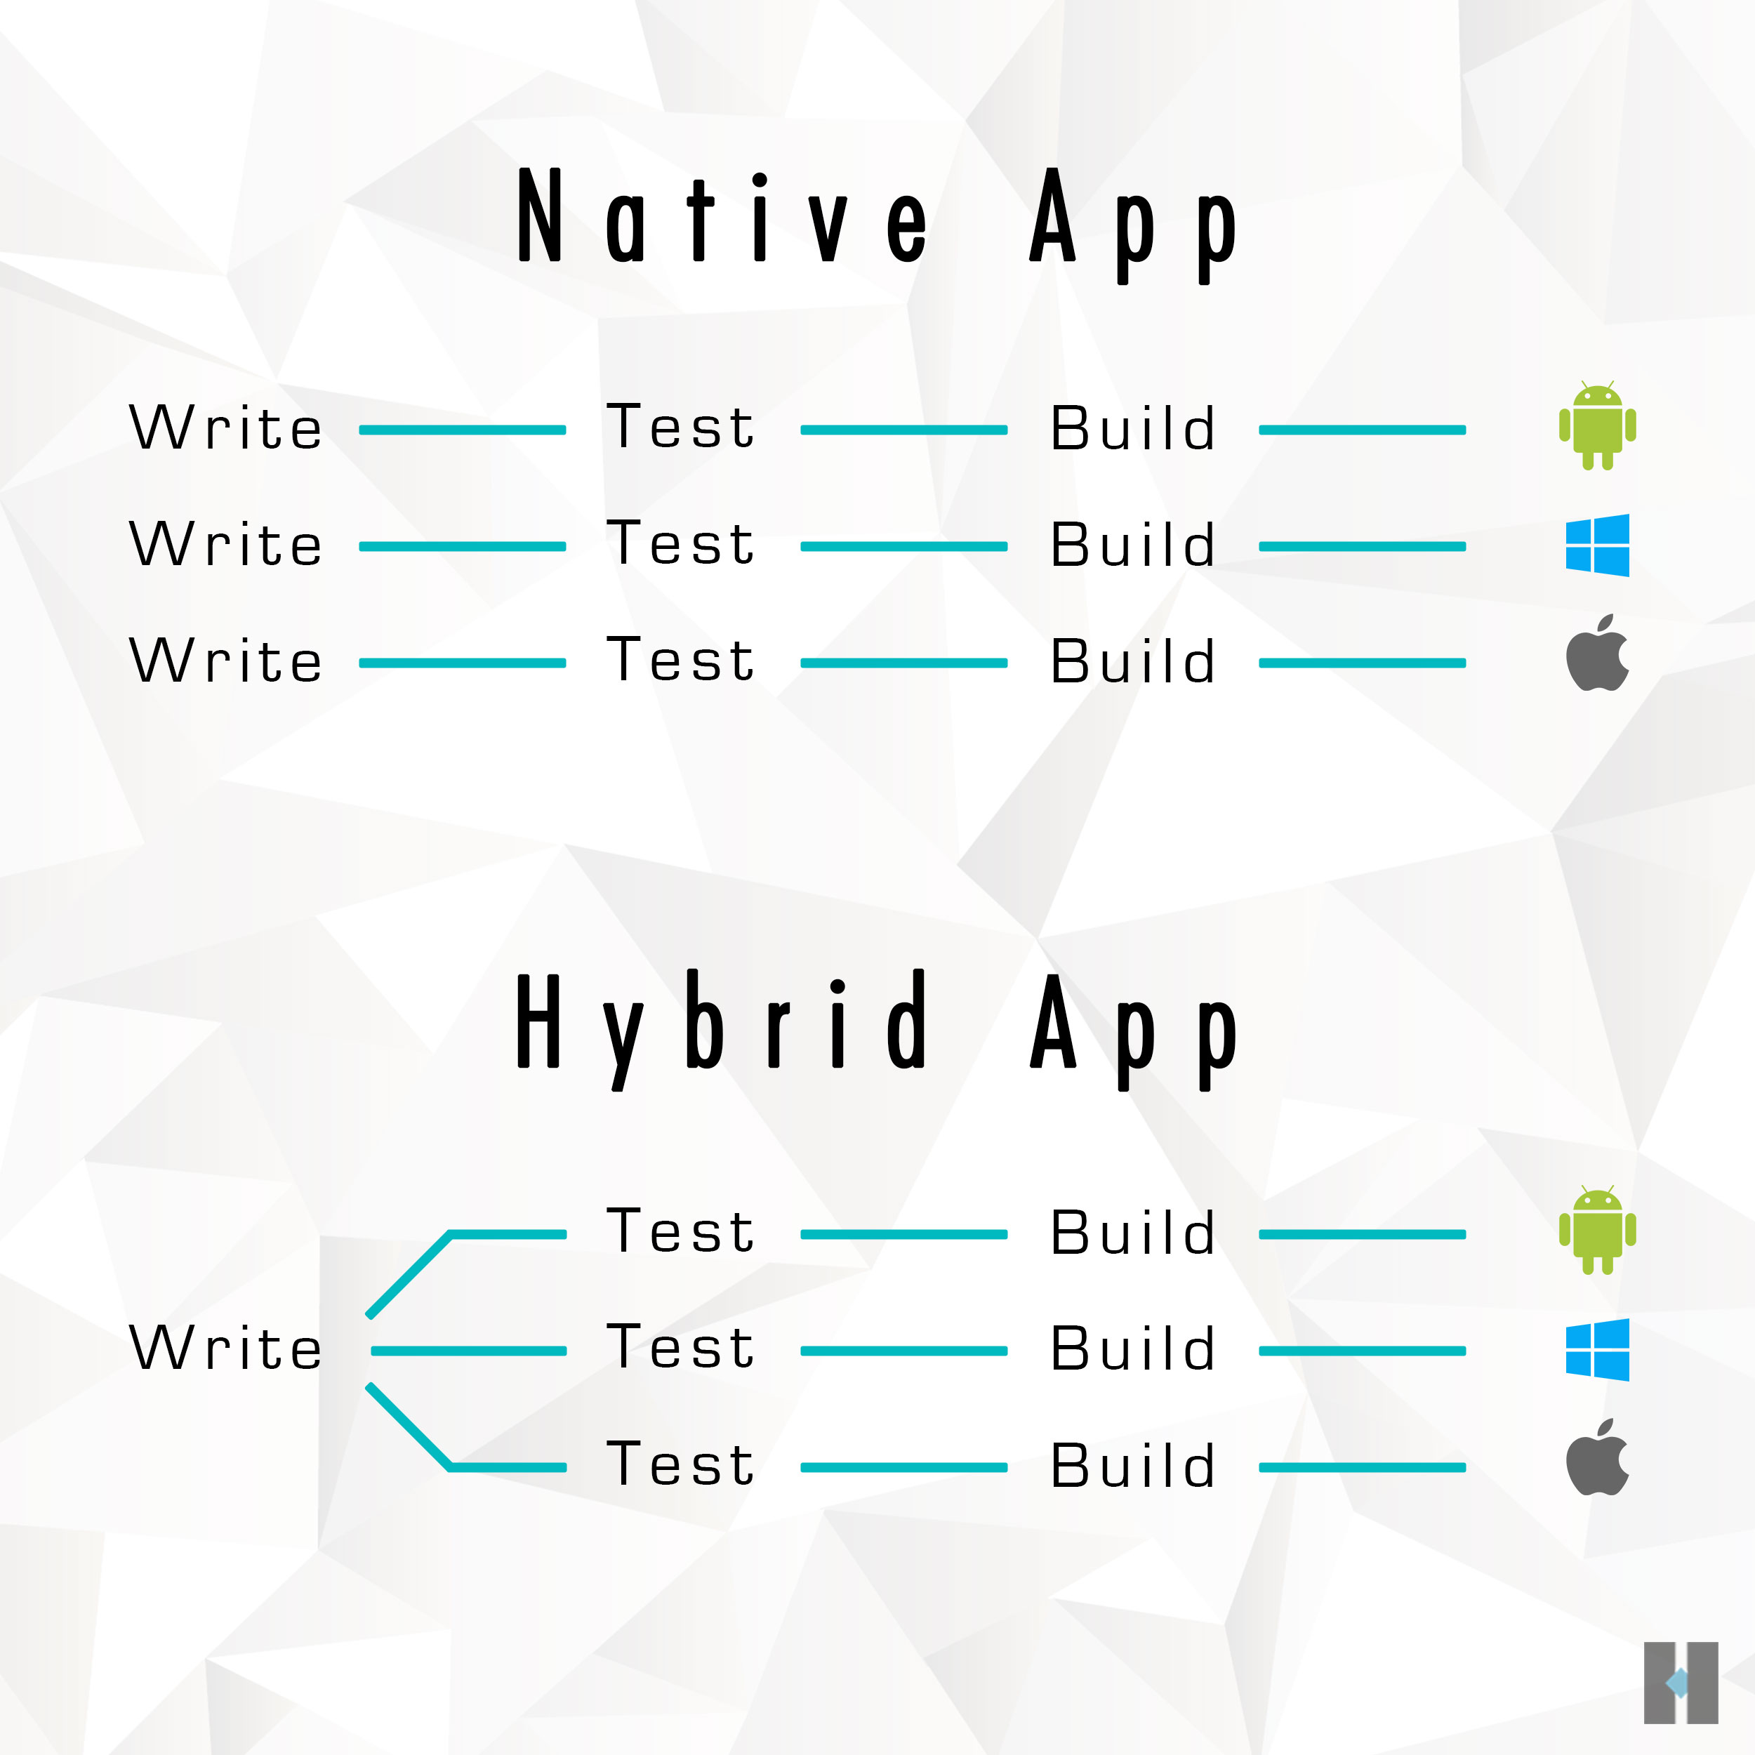
Hybrid Apps
Hybrid apps work on any device regardless of the operating system.
You can distribute hybrid apps through play store/app store and install them on devices.
Hybrid development environments include: Flutter, Iconic, React Native, Xamarin

Slide 19
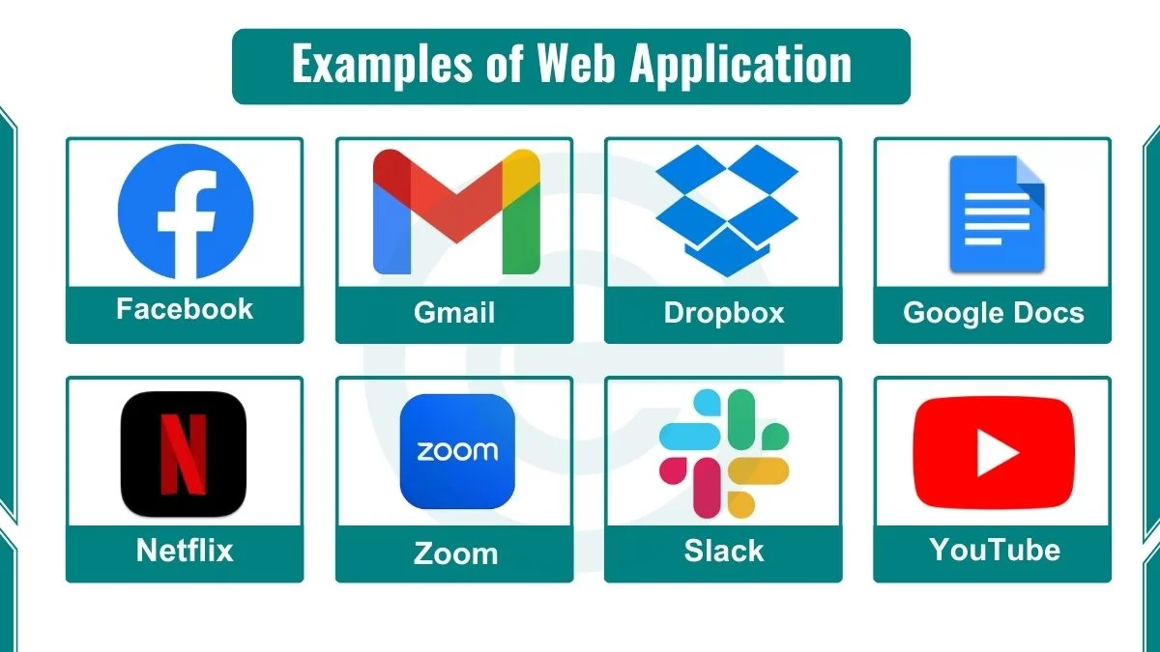
Web Apps
A web app or browser-based app can deliver similar functionality to an app as a website.
On the other hand, web apps can operate in browsers, and you can’t distribute the app through a play store /app store and install them on devices.
Wep app’s development language includes: web technologies (like HTML, CSS, and JavaScript).

Slide 20


Top mobile application development trends

Slide 21
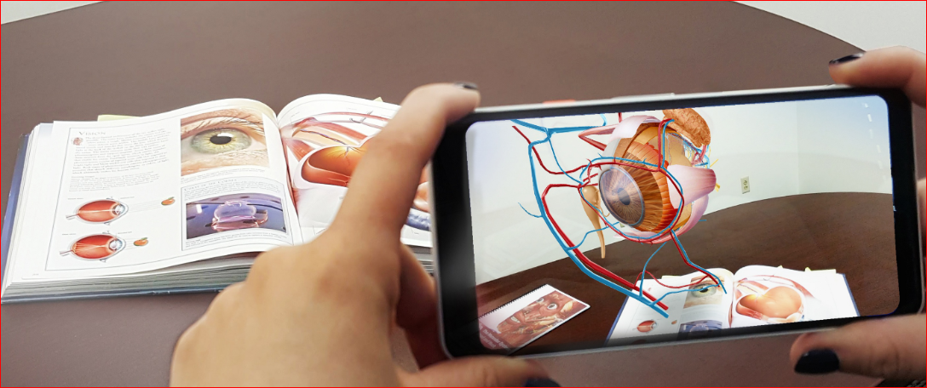
Augmented Reality
Combining real world with computer generated world e.g. snapchat , Instagram, pokeman Go

Slide 22
Artificial intelligence (AI)
  Improve user experience (Suggestions )
  e.g Amazon alexa , Apple face recognition

Slide 23
Choice of approach
Web apps
For less budget
Native app
For high performance app
For complex app
Hybrid app
To balance performance and budget
Economical
But, can’t access device features

Slide 24
≈∕ ∕≈

